Slide 1
Private Use of Outdoor Public Spaces
December 3, 2020

Slide 2
History
Resolution No. 2012-101 Established a one year demonstration project for the private use of public space for the purposes of outdoor seating.
Resolution No. 2016-18 Creating a pilot program to allow parklets and streateries on the street. Allowed up to four parklets or streateries to be permitted.
Resolution No. 2018-24 Extended the demonstration project through December 31, 2019
Resolution No. 2020-16 Extended the demonstration project through December 31, 2020 and added options for retail displays to support businesses during the COVID-19 pandemic.

Slide 3
Proposed Code
AN ORDINANCE, amending Title 7 of WCC, creating regulations and permit requirements for private use of City streets and sidewalks for sidewalk cafes, storefront enhancements and display of goods, parklets, and streateries.
The use of public streets and sidewalks for private uses is only permitted when the use is incidental to a legal permitted use (parklets are exempt from this requirement) and is limited to the frontage of property in which the subject use is occupied.
Restaurants and retail establishments may use the public space along its building frontage to display goods and storefront enhancements. Restaurants and retail establishments may place chairs, tables, and flower pots on the sidewalk on a temporary basis, tables and chairs placed in the sidewalk will be treated as public space amenity and be available to all public using the sidewalk.

Slide 4
Sidewalk Cafes
Sidewalk Café: Sidewalk cafes are areas of the sidewalk permitted under WCC 7.40.060. Sidewalk cafes are delineated areas that are under exclusive control of the operating business. Sidewalk cafes may provide for the serving of alcohol.
The use of the sidewalk shall only be allowed where sidewalk exists and the sidewalk width is in excess of 10 feet for sidewalk cafes.

Slide 5
Parklet & Streatery Boundaries
Fifth Street on the north end, Kittitas/Thurston on south end, railroad to the east, Chelan and Washington to the west.

Slide 6
Streateries
Streatery: A streatery is a facility that is used specifically to support an adjoining restaurant. A streatery can be controlled as an exclusive space for the restaurant during business hours. Streateries must remain open to the public after hours. Streateries are similar to sidewalk cafes except they occupy parking spaces instead of the sidewalk. Often streateries and sidewalk cafes are combined to create a larger outdoor dining space.
Parklets and streateries are only allowed within the boundaries of the Central Business District; only two parklets or streateries may be permitted per block, and only one parklet or streatery may be permitted on each side of the street. Each parklet or streatery is limited to a maximum of 40 linear feet, requests for additional footage will be reviewed by the Public Works Director on a case by case basis.
Design standards & guidelines to be developed in 2021.

Slide 7
Parklets
Parklet: A parklet is a public space that resembles a park typically with benches or seating areas and greenery such as flower baskets. Parklets include a creative design approach to add to the aesthetic. While parklets are often built to support local eateries, they may not be controlled by private businesses. Parklets are initiated and implemented by the City and required to be open to the public 24 hours per day, 7 days per week.
Parklets and streateries are only allowed within the boundaries of the Central Business District; only two parklets or streateries may be permitted per block, and only one parklet or streatery may be permitted on each side of the street. Each parklet or streatery is limited to a maximum of 40 linear feet, requests for additional footage will be reviewed by the Public Works Director on a case by case basis.
Design standards & guidelines to be developed in 2021.

Slide 8
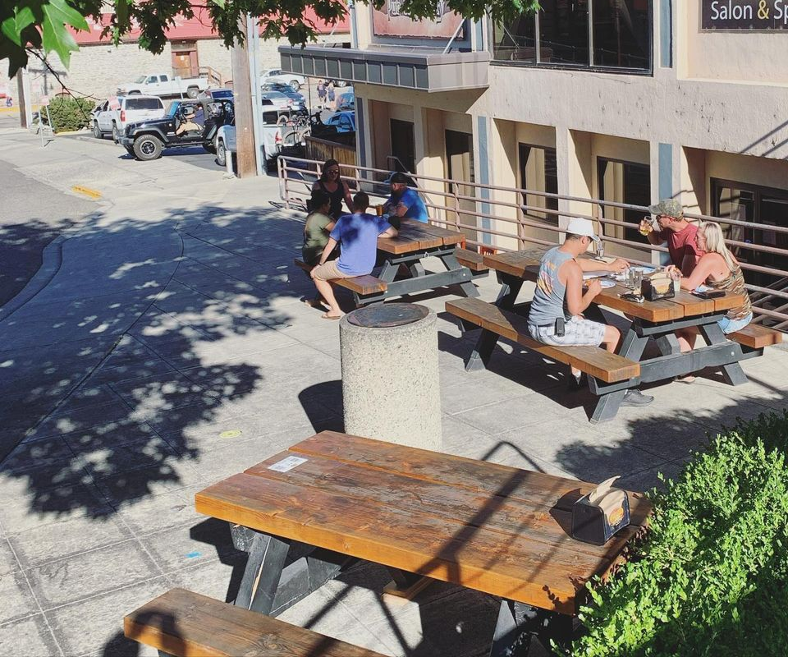
Additional Information
Proposed code includes two new fees - Sidewalk Cafe permit - $150.00, Streatery permit - $250.00
Planning Commission will draft design guidelines for parklets and streateries in 2021
Proposed code has been approved by the Wenatchee Downtown Association

Slide 9
Questions?

