Slide 1
City of Wenatchee Code Enforcement Tour
UPDATE: Before and Current
PURPOSE: On August 18, 2016 code enforcement staff conducted a tour with the Mayor, members of the City Council, and the Police Chief to certain properties that had open and active Code Enforcement Cases. Some cases were closed; some are still on-going.

Slide 2
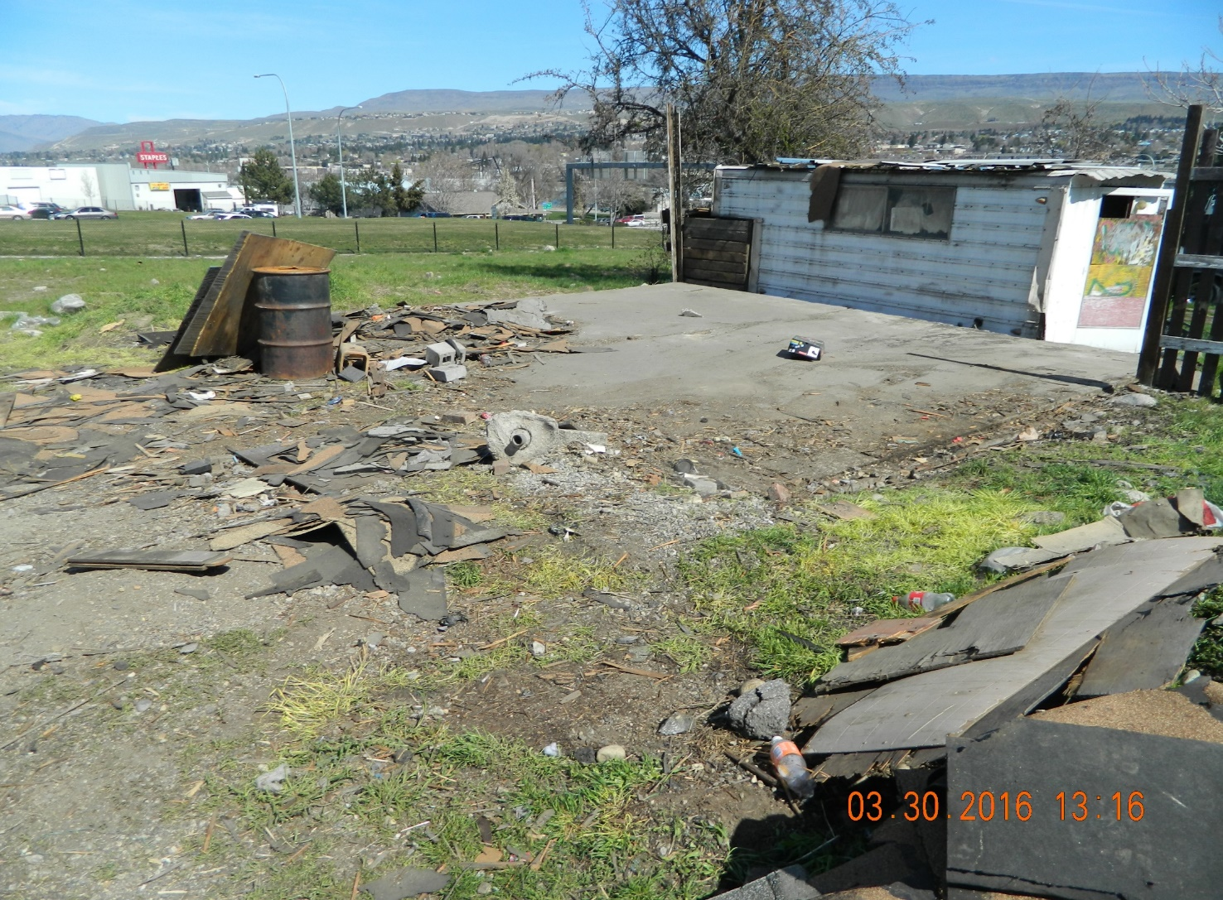
City of Wenatchee Code Enforcement Tour
1021 SOUTH MISSION: BEFORE
Case Opened: October 13, 2015
Case Closed: March 20, 2016
Buildings were demolished.

Slide 3
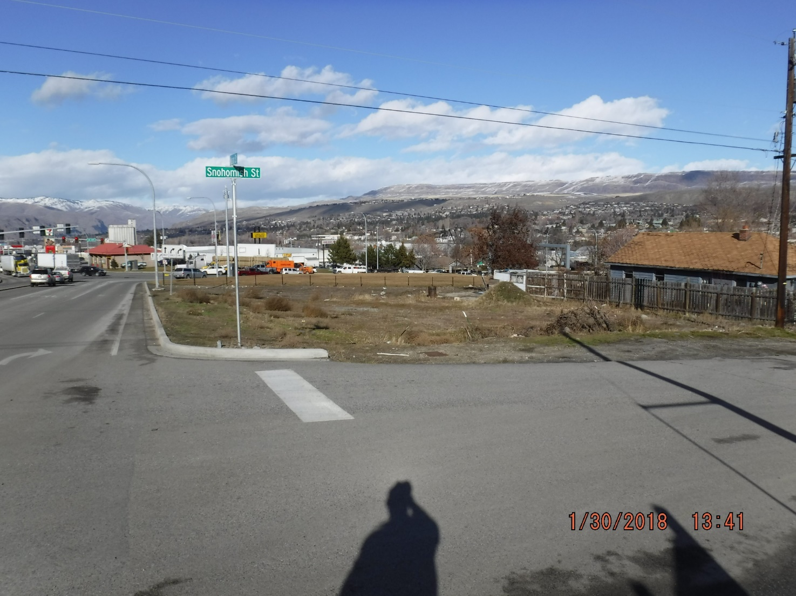
City of Wenatchee Code Enforcement Tour
1021 SOUTH MISSION: CURRENT
Case Opened: October 13, 2015
Case Closed: March 20, 2016
Land was purchased by
Department of Transportation
The lot remains empty.

Slide 4
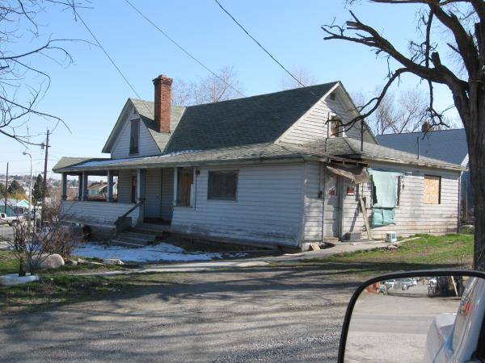
City of Wenatchee Code Enforcement Tour
307 STEVENS: BEFORE
Purchased by Benito Rodriguez on December 13, 2016.
House was secured to ward off vagrants.
Mr. Rodriguez owns “La Tortuga Loca”.
Ran out of money and has plans to work on the property in Summer of 2018.

Slide 5
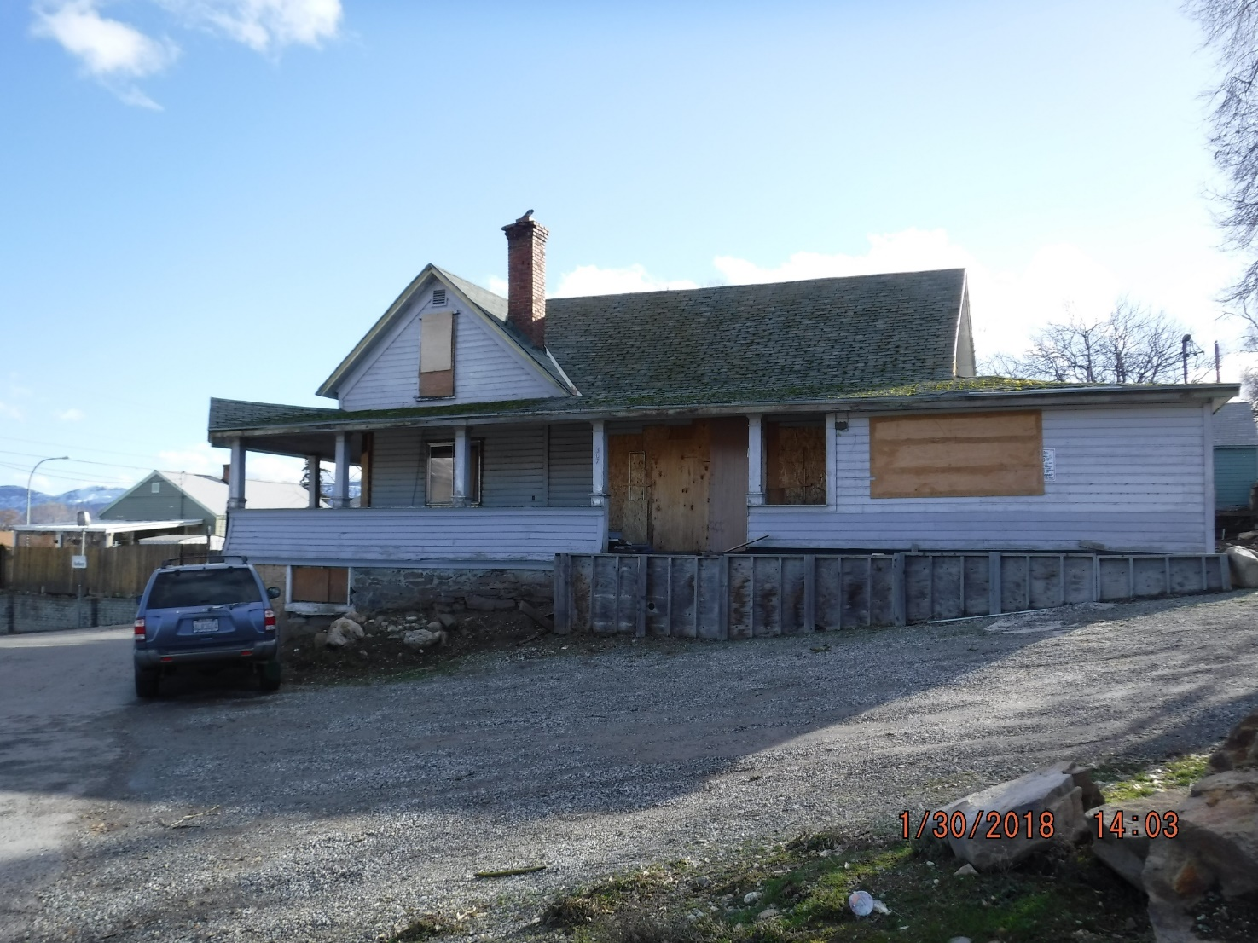
City of Wenatchee Code Enforcement Tour
307 STEVENS: CURRENT
Purchased by Benito Rodriguez on December 13, 2016.
House was secured to ward off vagrants.
Mr. Rodriguez owns “La Tortuga Loca”.
Began construction without proper permits, current Stop Work Order on building. Ran out of money and has plans to work on the property in Summer of 2018.

Slide 6
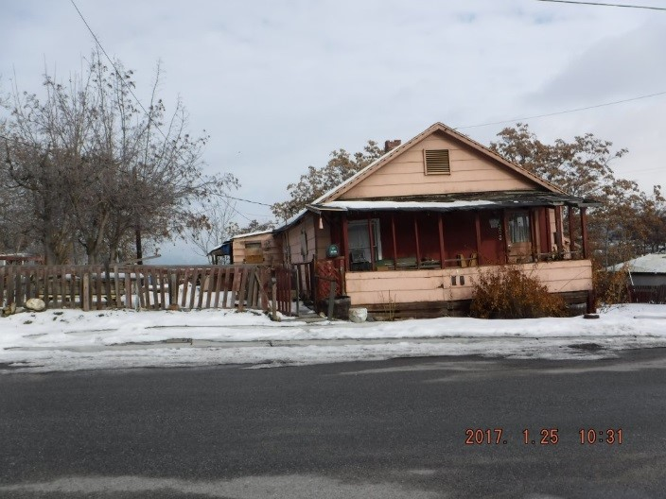
City of Wenatchee Code Enforcement Tour
308 STEVENS: BEFORE
Case Opened: November 14, 2016
Case Closed: May 11, 2017
House was vacated after property owner passed away.
Daughter (Delores Palmer) is current owner.
High pedestrian traffic area through the alley, adjacent to the property.

Slide 7
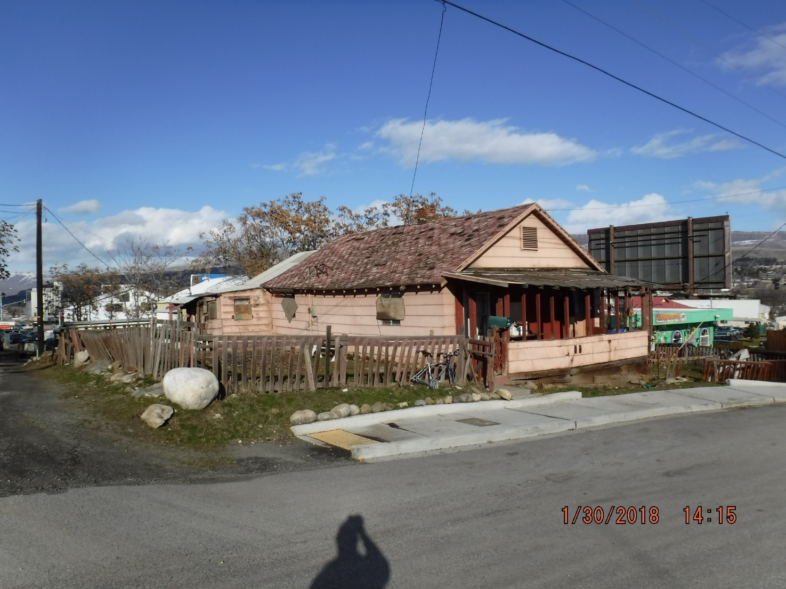
City of Wenatchee Code Enforcement Tour
308 STEVENS: CURRENT
House remains vacant.
Owner does not have the funding to demolish the house.
Property was posted Unlawful to Occupy, subject at house is a convicted felon who was illegally occupying structure, currently incarcerated for trespassing.

Slide 8
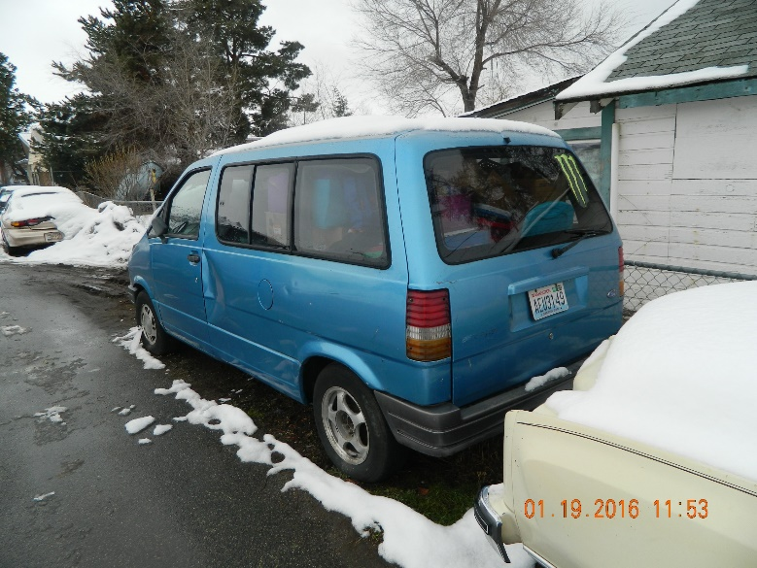
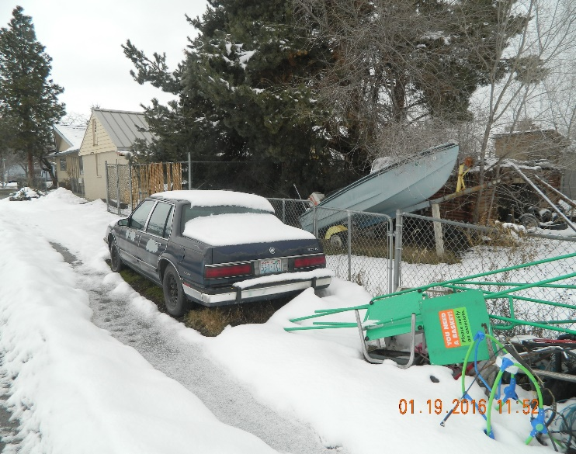
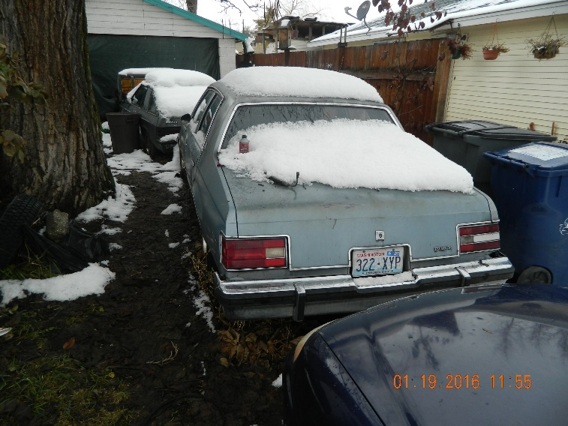
City of Wenatchee Code Enforcement Tour
1012 METHOW: BEFORE
Case Opened: November 15, 2015
Case Closed: August 10, 2017
The case was closed due to city attorney legal issues concerning deceased owner. Pending foreclosure action from Household Finance Corp . The occupants residing there have disclaimed any interest.
Numerous vehicles parked on Lincoln St which do not appear to be operational.

Slide 9
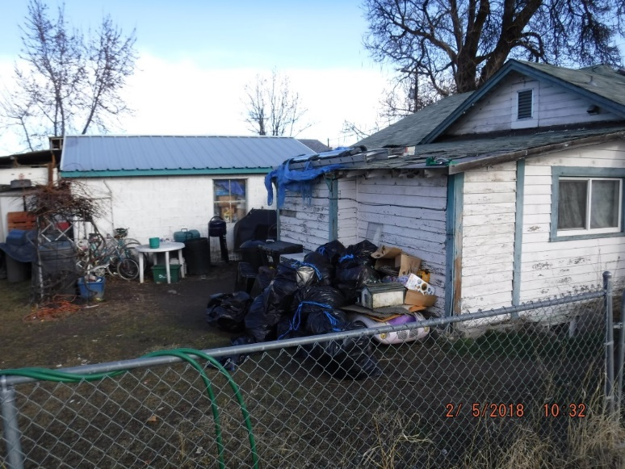
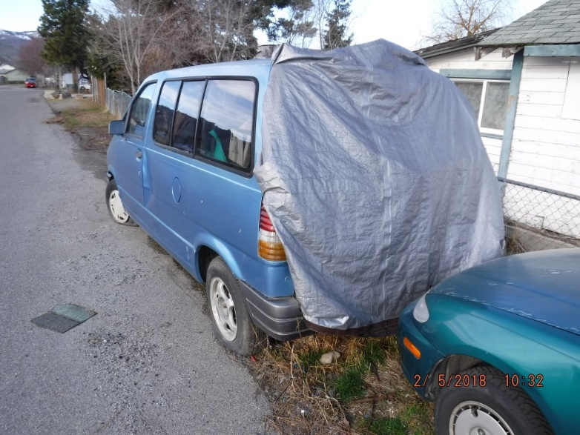
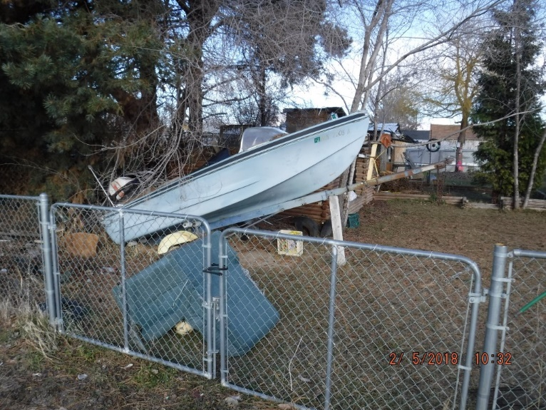
City of Wenatchee Code Enforcement Tour
1012 METHOW: CURRENT
The last known foreclosure documentation with the Assessor’s Office is October 22, 2015.
Numerous attempts to have the vehicles towed that are in the Right of Way have met with negative results.
Property still remains in disarray. Starting Receivership process may be the best opportunity to gain compliance on this property.

Slide 10
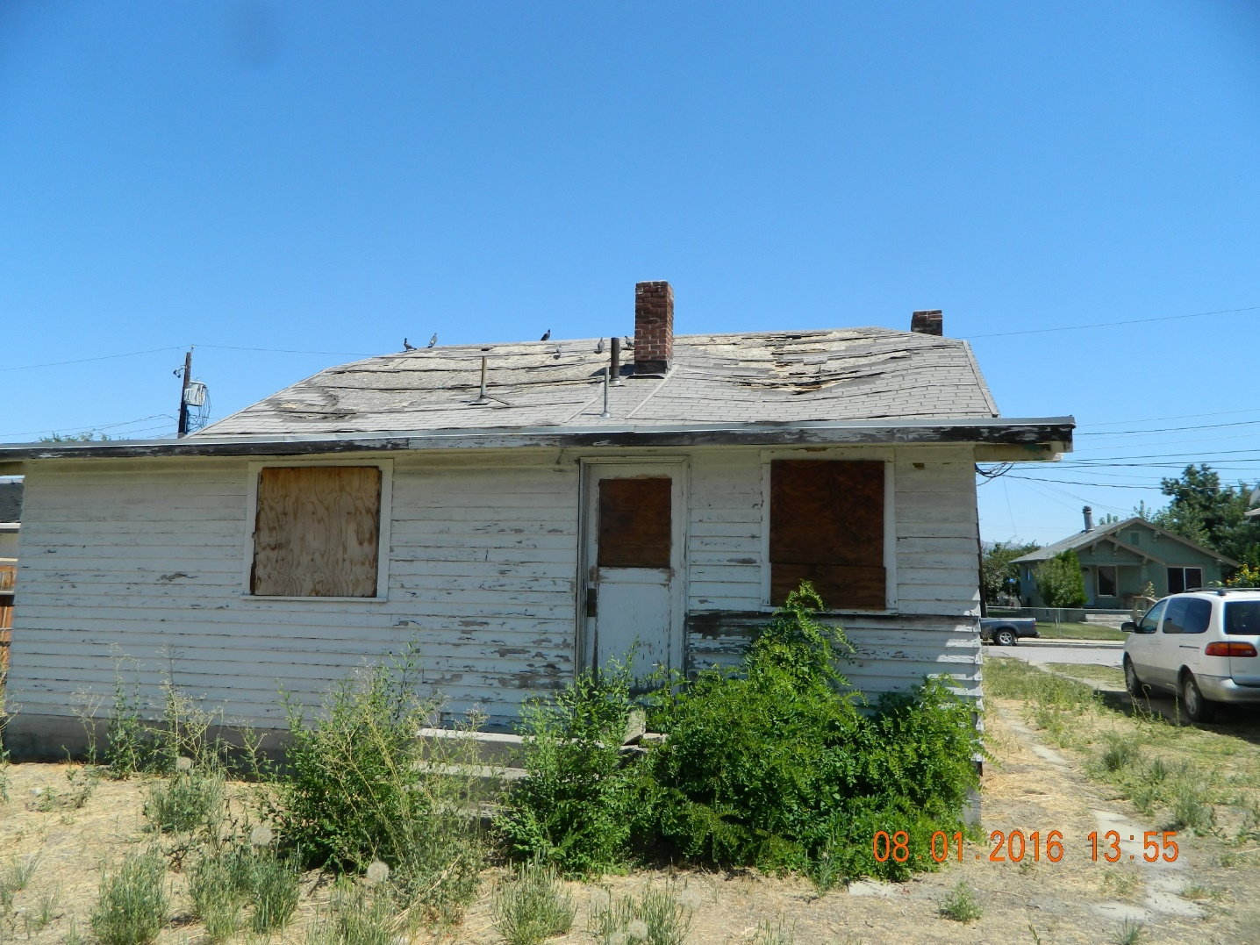
City of Wenatchee Code Enforcement Tour
926 WALKER AVE: BEFORE
Case Opened: August 5, 2016
Case Closed: June 8, 2017
Property owner was deceased and the case sat in probate for many years.
Staff took action to have house repaired or demolished.

Slide 11
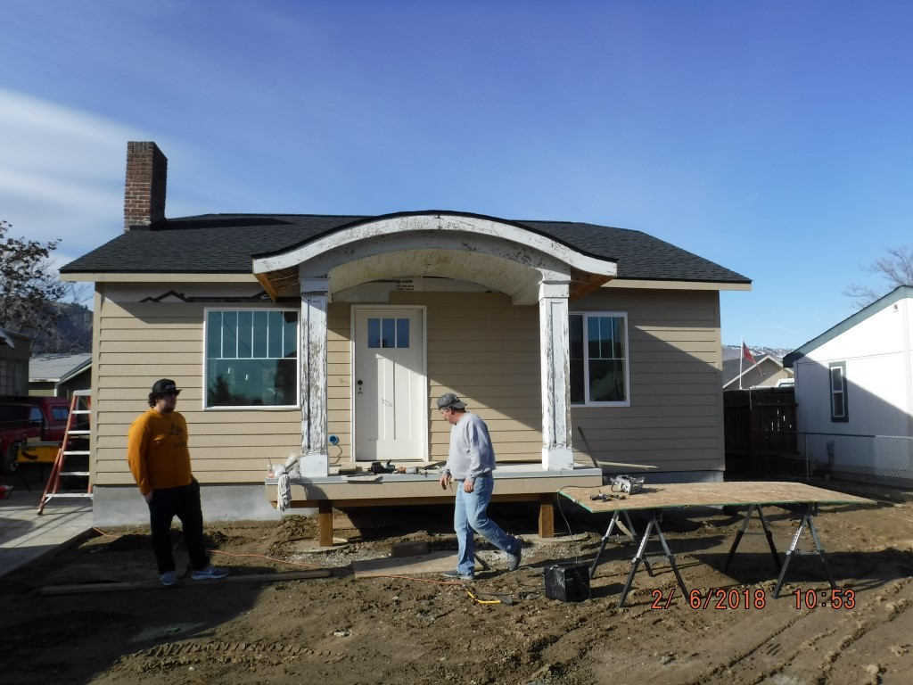
City of Wenatchee Code Enforcement Tour
926 WALKER AVE: CURRENT
Property was purchased on June 1, 2017.
Current owner is building with all necessary permits.
Owner plans on “Flipping” the home.

Slide 12
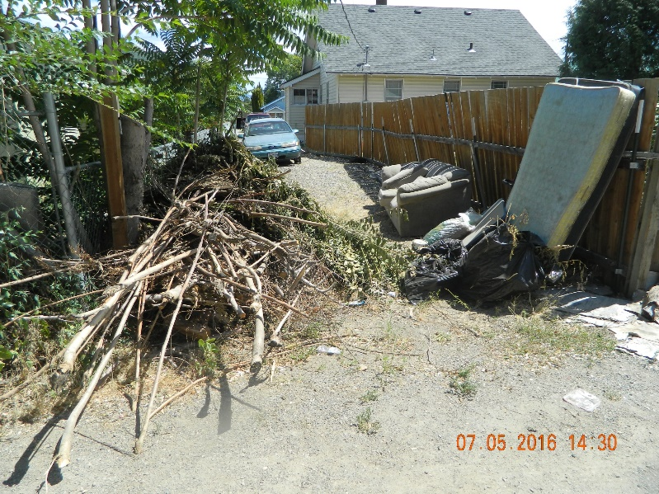
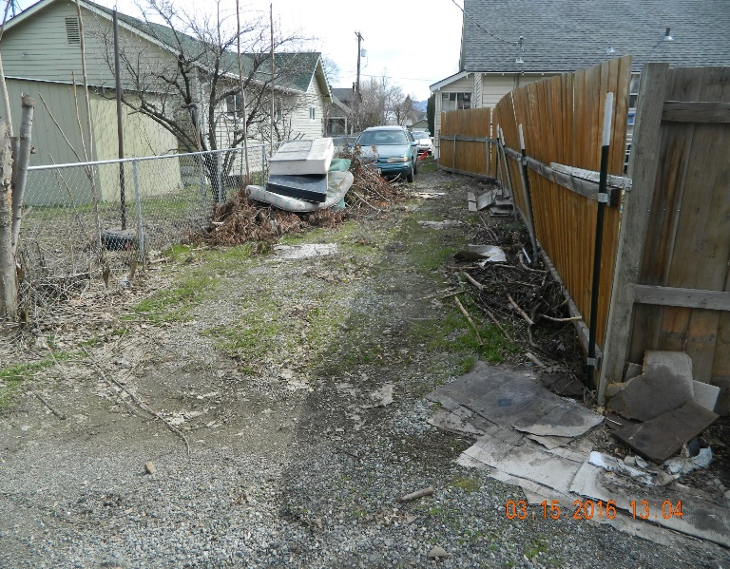
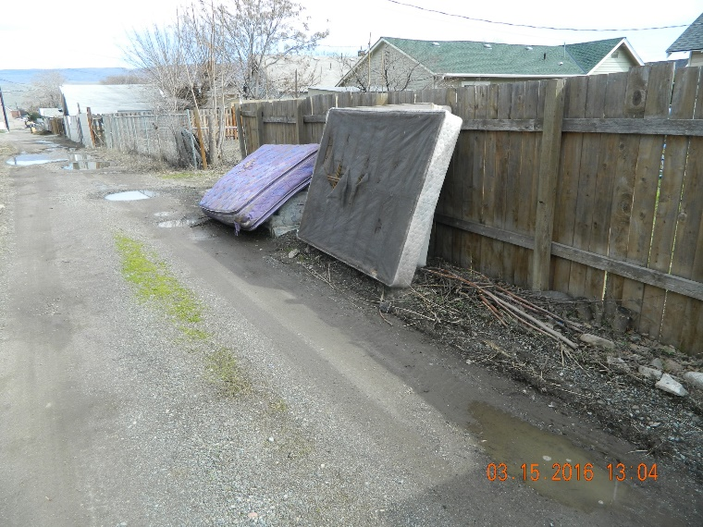
City of Wenatchee Code Enforcement Tour
930 ORONDO AVE: BEFORE
Case Opened: July 5, 2016
Case Closed: September 12, 2016
Health Department and the Humane Society were involved with the compliance of this case.
Excess pets (Dogs & Cats) were removed from the property and the owner was issued a kennel license through the Humane Society so they could be more closely monitored.

Slide 13
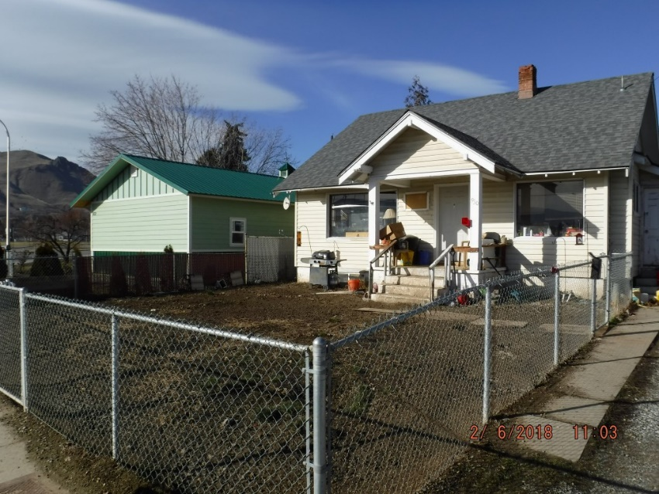
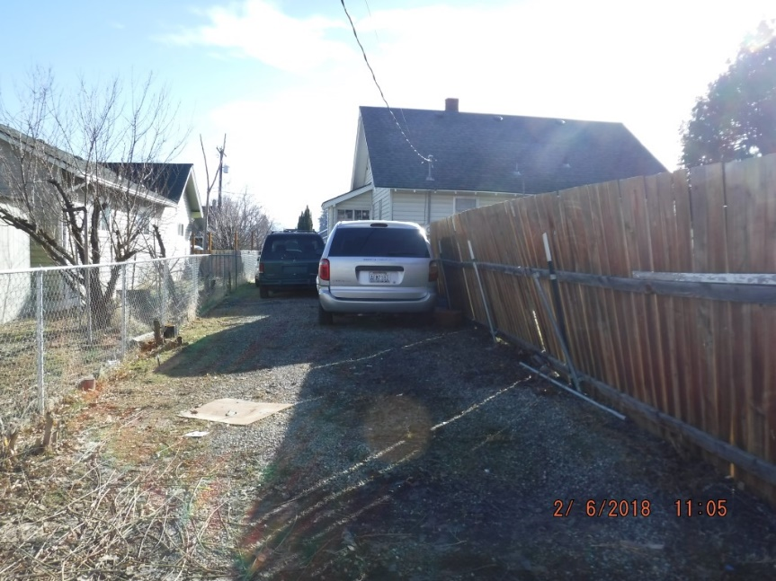
City of Wenatchee Code Enforcement Tour
930 ORONDO AVE: CURRENT
Property is in and out of compliance.
Since the Code Enforcement Tour, two additional cases have been opened and closed, ranging from property maintenance to chronic nuisance.
The Humane Society is still monitoring the property/owner in regards to pets.
Staff is in the process of opening another case for garbage, debris and animal feces.

Slide 14
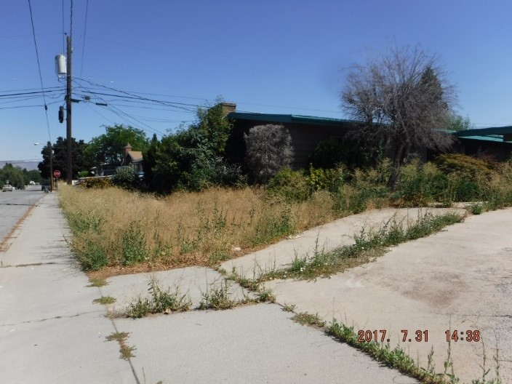
City of Wenatchee Code Enforcement Tour
1101 WEDGEWOOD: BEFORE
Case Opened: May 11, 2016
Case Closed: September 13, 2017
Property remained vacant for years, which also became a Fire Code Violation.
Unknown person(s) entered the home and started a fire, the house was secured with boards over the windows and doors.
Neighbors were complaining of rats, which were nesting on the property.
Fire Code Abatement conducted on August 10, 2017.

Slide 15
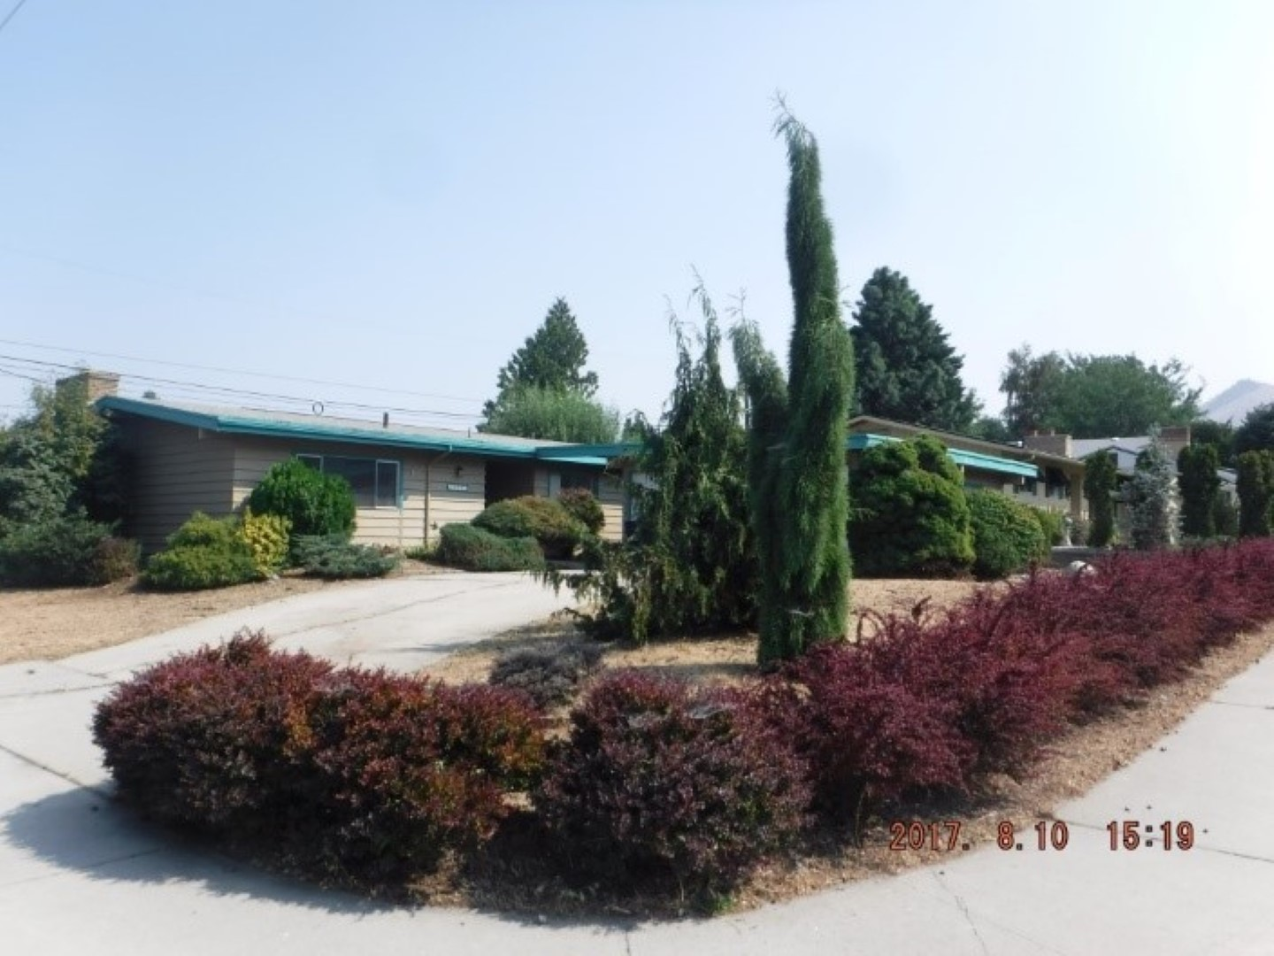
City of Wenatchee Code Enforcement Tour
1101 WEDGEWOOD: CURRENT
The home was purchased via Chelan County Auction on November 16, 2017.
The current owner plans on “Flipping” the home.

Slide 16
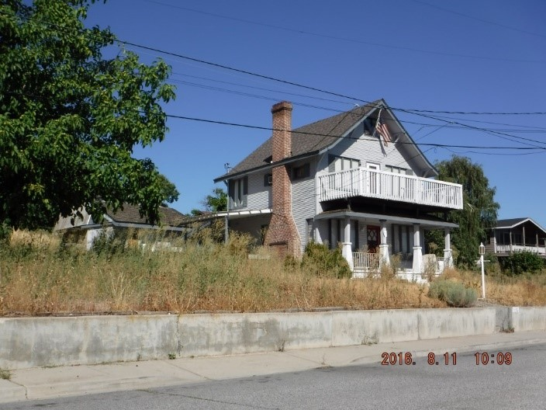
City of Wenatchee Code Enforcement Tour
1142 APPLELAND DRIVE: BEFORE
Case Opened: May 6, 2016
Case Cancelled: November 8, 2016
Case Opened: November 9, 2016
The case was initially closed at the request of the City Attorney for procedural modifications.
All documentation was mailed to the City Attorney on May 2, 2017.

Slide 17
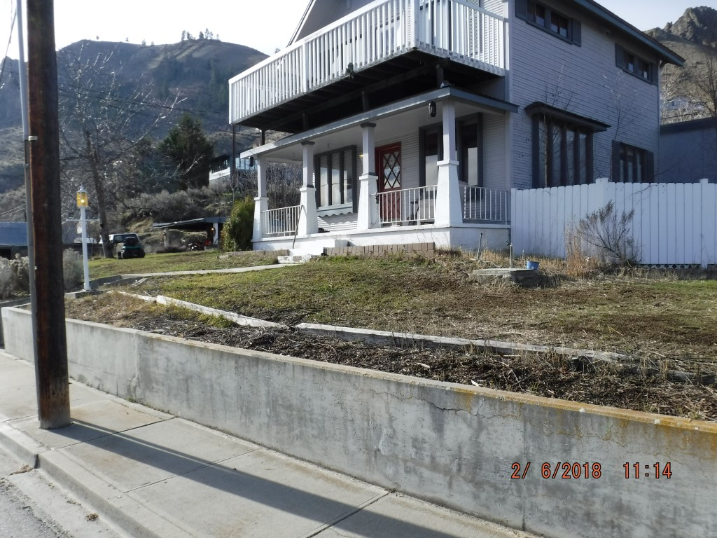
City of Wenatchee Code Enforcement Tour
1142 APPLELAND DRIVE: CURRENT
The property owner was just released from jail and the family has been cleaning up the property, still has work to complete to come into compliance.
The case still remains with the City Attorney.

Slide 18
City of Wenatchee Code Enforcement Tour
Address | Total Billed | Attorney Fees | Total Paid | Date to Collections | Amount Collected
1021 S. Mission St. | 0 |  | 0 | N/A | N/A
307 Stevens St. | 0 |  | 0 | N/A | N/A
308 Stevens St. | 0 |  | 0 | N/A | N/A
1012 Methow St. | 0 | $1,041.70 | 0 | N/A | N/A
926 Walker Ave. | 0 |  | 0 | N/A | N/A
930 Orondo Ave. | $154.56 |  | 0 | 12/16/2016 | Actively Pursuing
1101 Wedgewood Ave | 0 | $943.40 | 0 | N/A | N/A
1142 Appleland Dr. | $6,446.44 | $2,216.30 | 0 | 11/16/2016 | Actively Pursuing
Notes:
NOTE: Total billed should come from City Attorney in regards to all billing and fees due.
1021 S. Mission: Property Owner Complied
307 Stevens St.: Planned future renovation
308 Stevens St.: Building Should be inspected and/or condemned. If process begins to demo the structure, the city will most likely incur all costs.
1012 Methow St.: Collections did occur in the amount of $4,610.33. However, this person had nothing to do with the property. Property Owner is deceased.
1101 Wedgewood Ave: Property Owner is deceased and remained with the bank for a long time.
NOTE: ONLY 1101 WEDGEWOOD HAS BEEN ABATED.

Slide 19
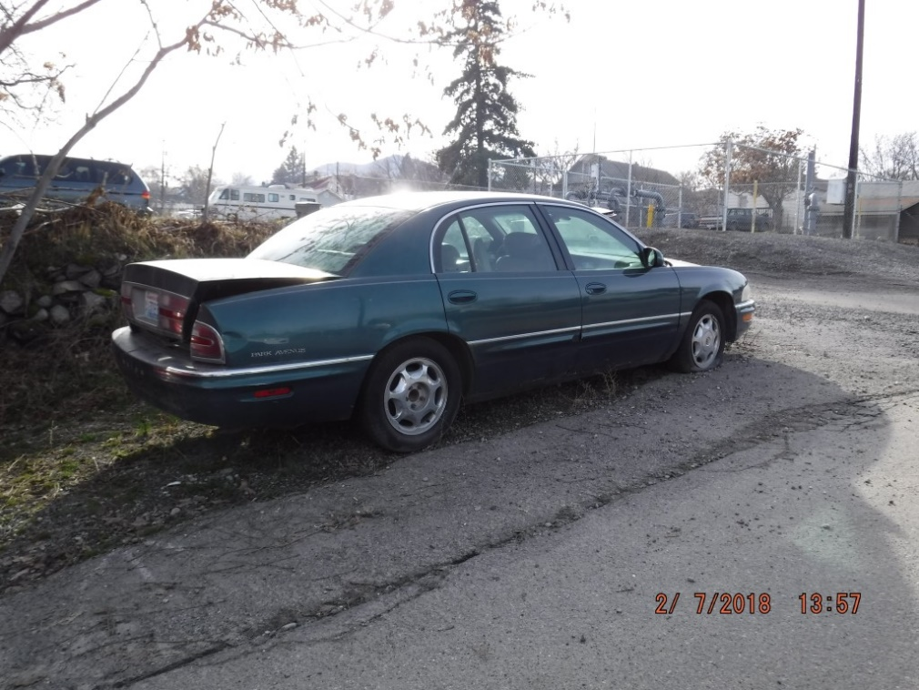
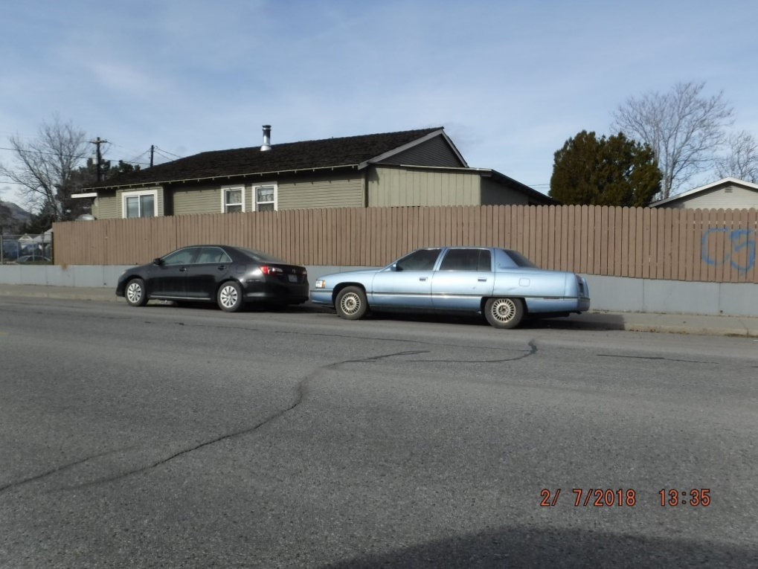
City of Wenatchee Code Enforcement
Public nuisances, which include inoperable/junk vehicles, rubbish, garbage, overgrown vegetation on private and public land are a majority of cases that are open. However, numerous complaints have been received in regards to street parking.
The following photo’s are examples of vehicles of which members of the community complain about in regards to parking in their respective areas:
839 Cascade
Vehicles have not moved in 30 days or more.
205 Snohomish St.
Inoperative Vehicle.

Slide 20
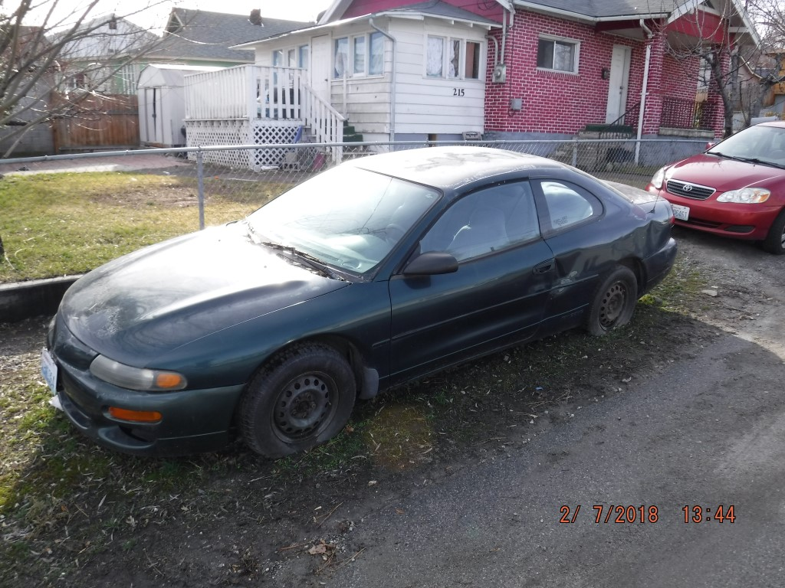
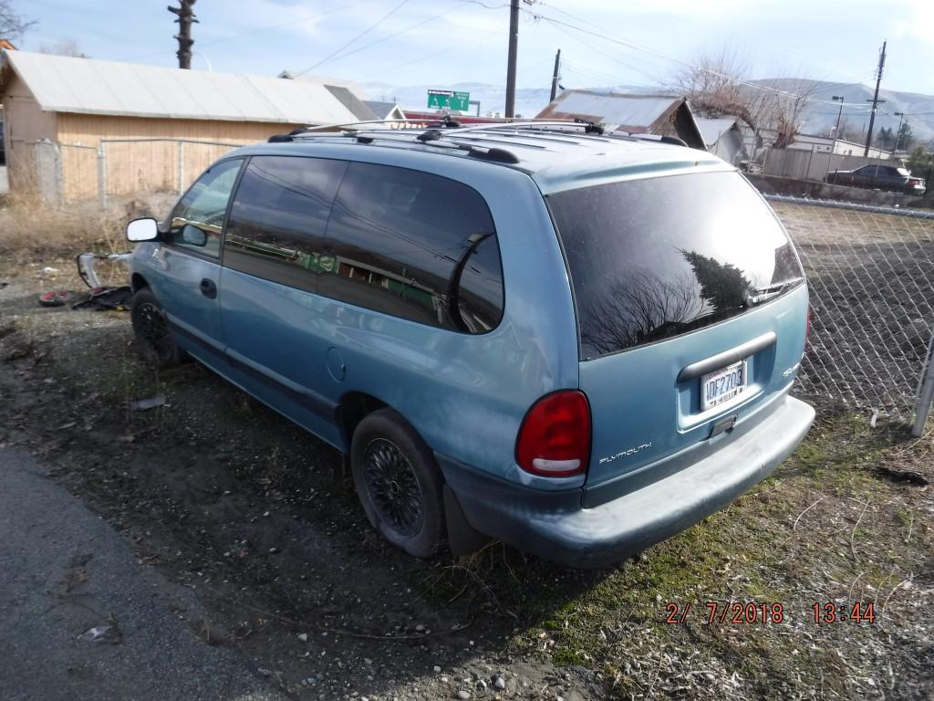
City of Wenatchee Code Enforcement
215 Lewis St.
Inoperative Vehicle.
215 Lewis St.
Inoperative Vehicle.

Slide 21
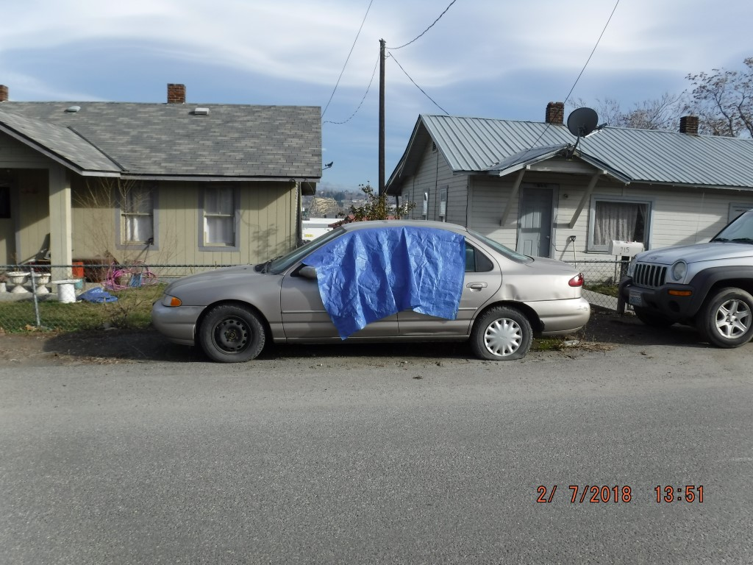
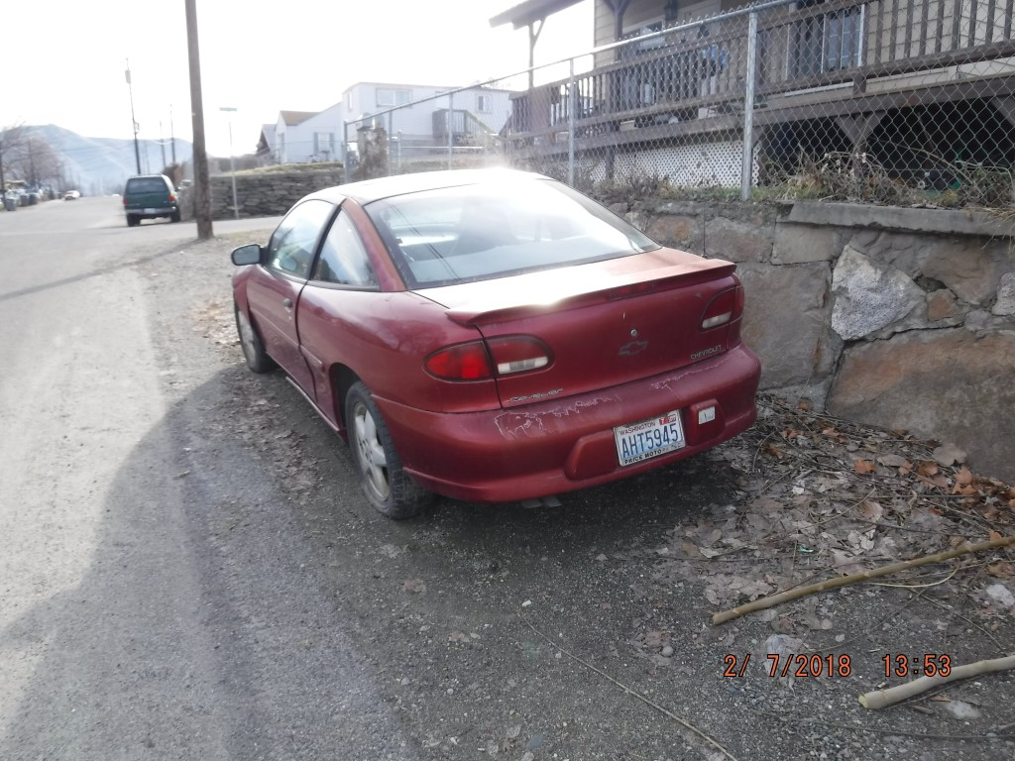
City of Wenatchee Code Enforcement
915 Monitor
Inoperative Vehicle.
1020 Monitor
Inoperative Vehicle.

Slide 22
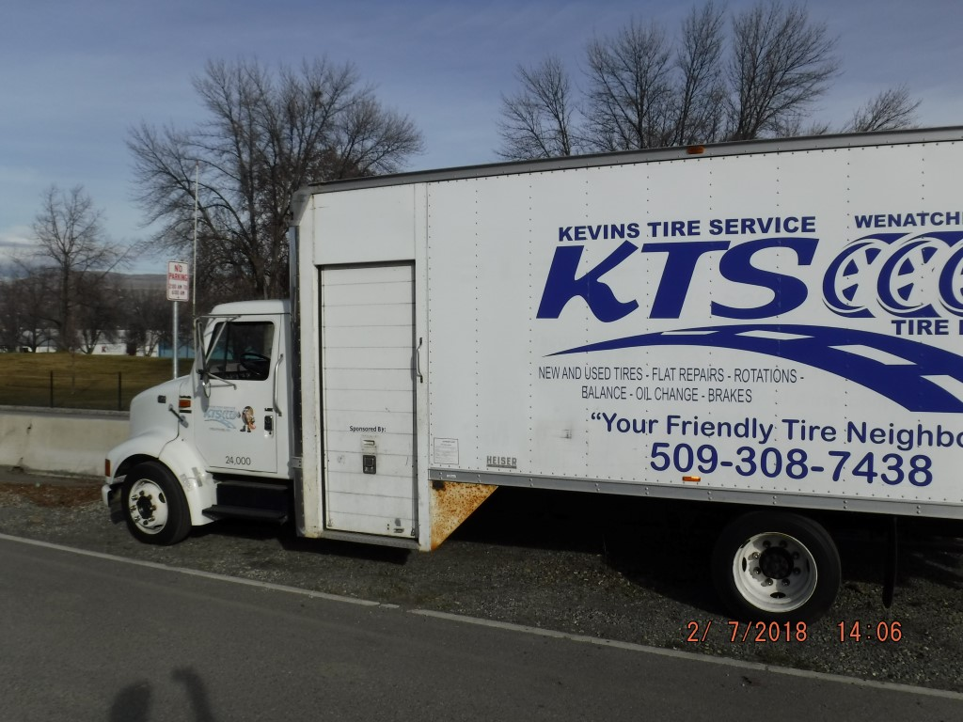
City of Wenatchee Code Enforcement
1106 Crescent St.
Illegally parked.

Slide 23
City of Wenatchee Code Enforcement
Code Enforcement ensures that violations of the Wenatchee City Code affecting the health, safety, and welfare of the community are brought into compliance by the responsible party through:
Proactive Community Oriented Interactions (Communicating with members of the Community).
Reactive Citizen Complaints
Partnerships with local agencies such as:
Wenatchee Police Department
Chelan County Health Department
Chelan County Assessor
Chelan County Treasurer
Various Volunteer Organizations
Local Church volunteers
Other City Departments
Waste Management

Slide 24
City of Wenatchee Code Enforcement
QUESTIONS/COMMENTS?

